Slide 1

Periods where Fed held rates
 | 1993 | 2002 | Jul2003 – Jun 2004 | 2020 (forecast)
EFFR | 3.00% | 1.75% | 1.25% | 1.75%
GDP | 2.80% | 1.70% | 3.10% | 2.00%
Unemployment Rate | 5.50% | 6.00% | 6.00% | 3.70%
Inflation Rate | 2.70% | 2.40% | 3.3% | 2.70%

Slide 2
EuroDollar Futures Moves
EuroDollar futures did not move much on a daily and weekly basis
Data used: EDc1 to EDc16

Slide 3
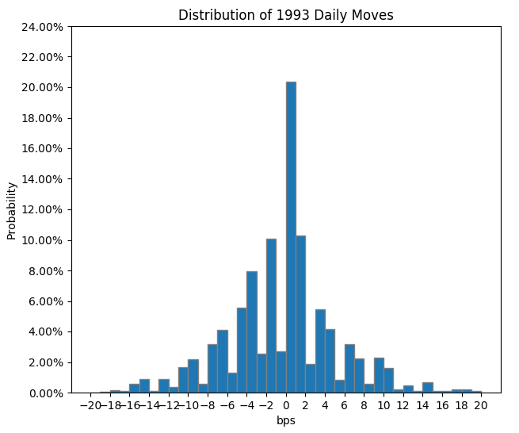
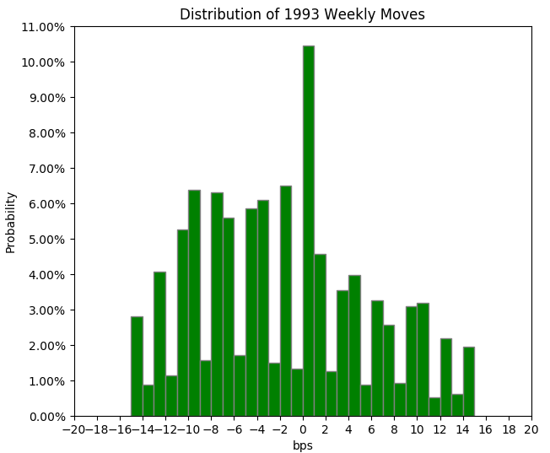
1993
Daily moves | 1993
Between -5bp to 5bp | 69.92%
Less than -5bp | 16.10%
Less than -10bp | 5.03%
More than 5bp | 13.99%
More than 10bp | 5.03%
Weekly moves | 1993
Between -5bp to 5bp | 32.61%
Less than -5bp | 39.04%
Less than -10bp | 23.44%
More than 5bp | 28.35%
More than 10bp | 20.56%

Slide 4
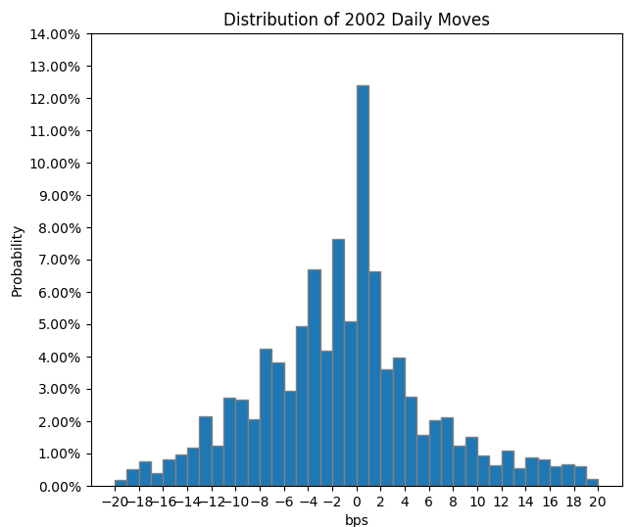
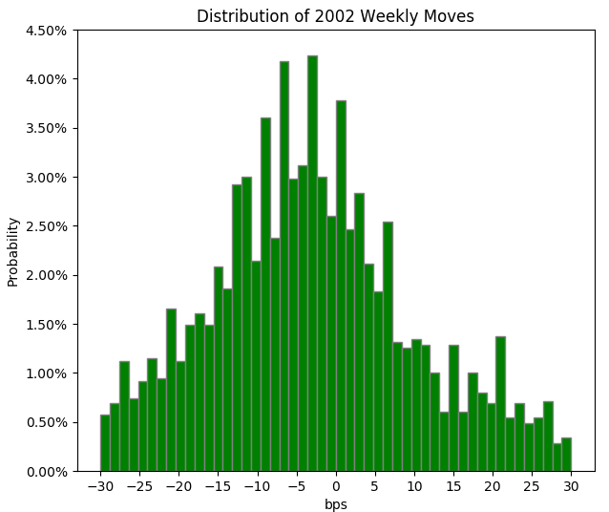
2002
Daily moves | 2002
Between -5bp to 5bp | 55.39%
Less than -5bp | 27.14%
Less than -10bp | 12.11%
More than 5bp | 17.47%
More than 10bp | 9.35%
Weekly moves | 2002
Between -5bp to 5bp | 27.70%
Less than -5bp | 46.72%
Less than -10bp | 33.10%
More than 5bp | 25.58%
More than 10bp | 18.69%

Slide 5
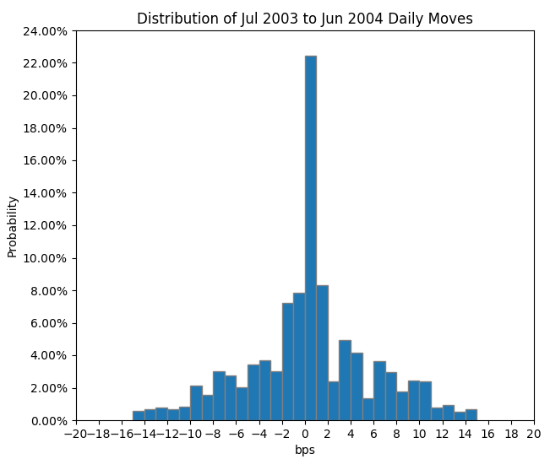
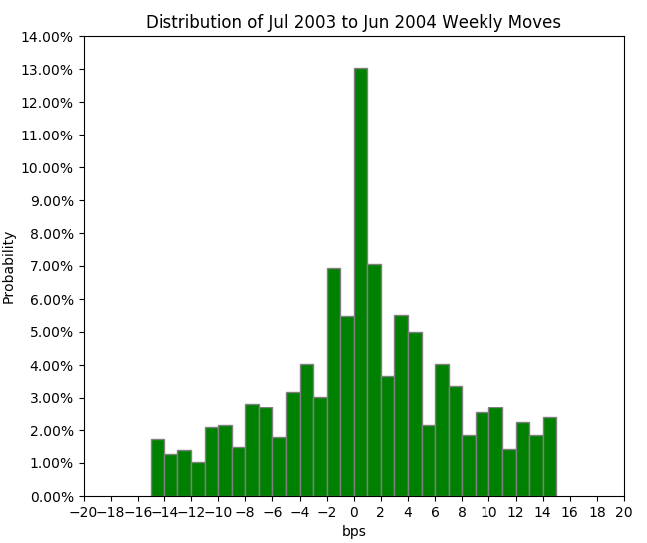
Jul 2003 to Jun 2004
Daily moves | 2003-2004
Between -5bp to 5bp | 62.06%
Less than -5bp | 17.37%
Less than -10bp | 6.82%
More than 5bp | 20.56%
More than 10bp | 9.41%
Weekly moves | 2003-2004
Between -5bp to 5bp | 38.26%
Less than -5bp | 24.42%
Less than -10bp | 17.07%
More than 5bp | 37.33%
More than 10bp | 27.95%

Slide 6
EDcm Spread
Edcm spreads narrowed in 1993 and 2002
Edcm spreads widened between Jul 2003 to Jun 2004

Slide 7
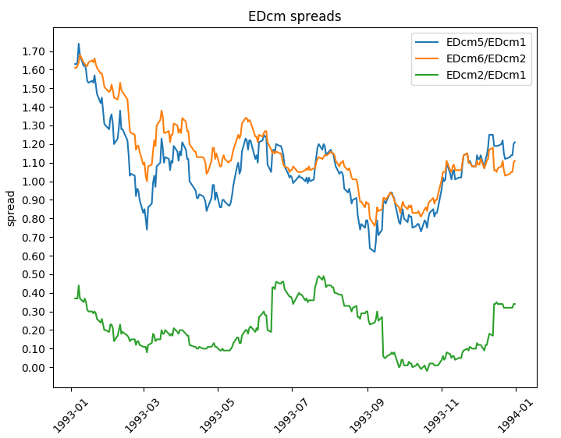
1993
Next Rate Decision: 4 Feb 1994
Fed raised rates to keep economy healthy
3.00% to 3.25%

Slide 8
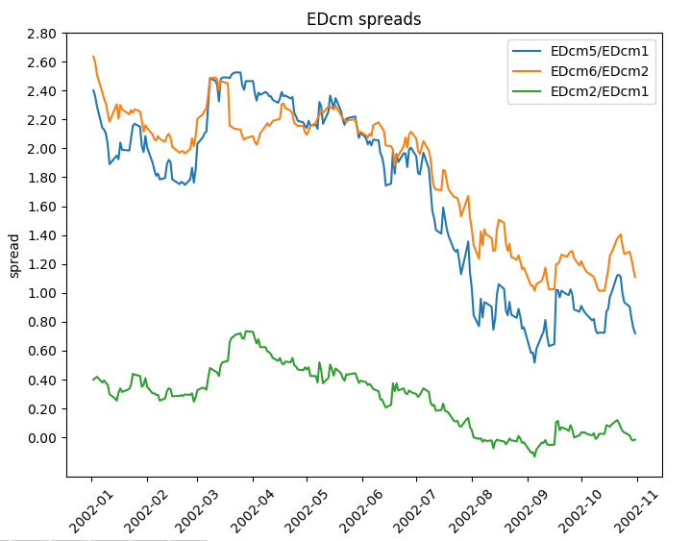
2002
Next Rate Decision: 6 Nov 2002
Fed lowered rates to fight sluggish growth
1.75% to 1.25%

Slide 9
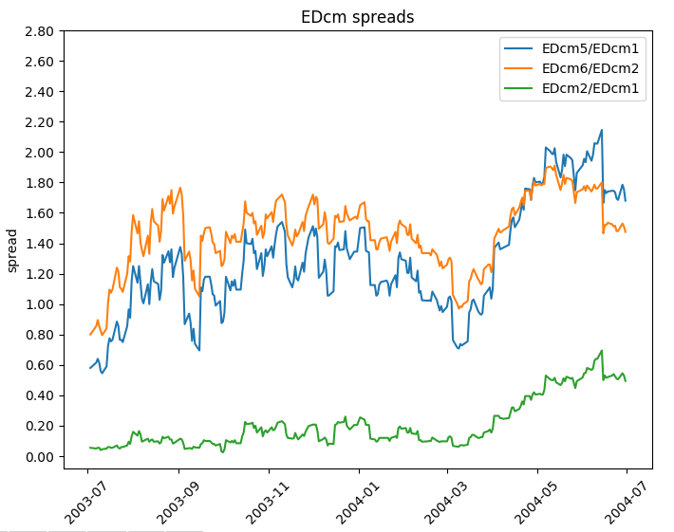
Jul 2003 to Jun 2004
Next Rate Decision: 30 Jun 2004
Fed hiked rates
1.00% to 1.25%

Slide 10
1993
1993 was characterised by substantial swings in the outlook for economic activity and inflation
Initial projection in 1992 of 1993’s economy: FOMC projected that the economy would grow at a healthy pace in 1993
Expecting a 3-3.25% of GDP
Downward trend of inflation: CPI between 2.5% to 2.75%
Second quarter of 1993
Revise estimate of real GDP growth rose less than 1 percent in the first 3 months of 1993
CPI was accelerating, at 4.25% in Apr 1993
High inflation rate was unexpected because there has been a deceleration in M2 growth and historically, M2 growth and inflation rate has been somewhat correlated
Third quarter of 1993:
Central bank showed tightening bias due to inflation concern
Revised real GDP growth to be 2.25% to 2.75%
CPI revised upwards to 3 to 3.25%
The mere hint of policy tightening bias in May 1993 appear sufficient to reassure market participants of a monetary policy response in the event of a persistent inflation flare up
Notes:
https://www.clevelandfed.org/en/newsroom-and-events/publications/economic-commentary/economic-commentary-archives/1994-economic-commentaries/ec-19940101-monetary-policy-and-inflation-1993-in-perspective.aspx

